Slide 1
FSA ID
What you’ll need:
Social Security Number
Your mobile phone number
Personal email address
Address

Slide 2

FAFSA Overview
Free Application for Federal Student Aid = FAF$A
FAFSA is two parts:
  1. FSA ID – binding FAFSA electronic signature
  2. FASFA Application
FAFSA application opens 12-1 tentatively.
Each school determines their priority deadlines for FAFSA completion.
Each college/university/career school determines how much and what type of financial aid you will receive.
You must complete FAF$A to receive grants, loans, and some scholarships for college.

Slide 3
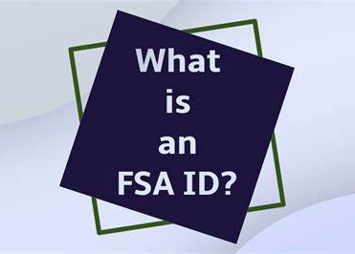
What is a FSA ID?
The FSA ID is an electronic signature used to sign the Free Application for Federal Student Aid (FAFSA) and federal education loan promissory notes.
The FSA ID consists of a username and a password. It is sometimes called a FAFSA ID. You must file the FAFSA in order to get a federal student loan.
This electronic identification provides a single sign-on for accessing various U.S. Department of Education websites , including fafsa.gov and studentaid.gov
An FSA ID is required to submit the application.

Slide 4

When to get a FAFSA ID
You can get an FSA ID at any time. You do not have to wait until the FAFSA is available to get an FSA ID. It is best to get an FSA ID early, before you apply for financial aid, just in case there are problems.
Create and Access Your StudentAid.gov Account (youtube.com)

Slide 5
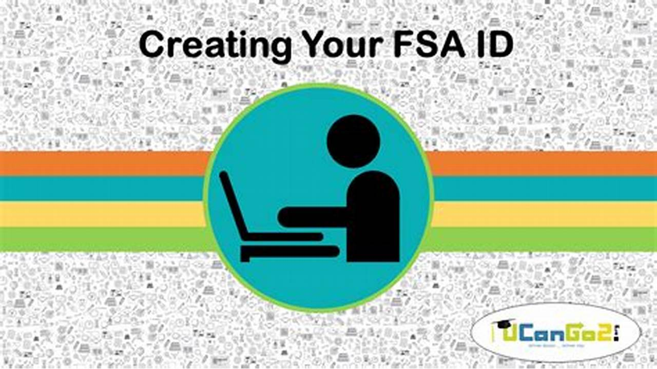
Who should get an FSA ID?
The student and the student’s parent (if the student is a dependent student) each need their own FSA ID. Each FSA ID must be associated with a different email address.
The parent should not create an FSA ID for the student and the student should not create an FSA ID for the parent. Doing so often leads to problems. It is also illegal.
Never share your FSA ID with anybody, not even a relative.
Please save your FSA ID username and password in your phone.

Slide 6

Create your FSA ID – Follow worksheet
studentaid.gov/fsa-id/create-account/launch
Click Get Started
Enter Personal Information
Create Username and Password
Verify your Email address
Complete Challenge questions
2-step verification
  Store your backup code in your phone
Review and submit
Make sure to write down or take a picture of your FSA ID username and password as a reminder!
Repeat the process to have your parent create an FSA ID, too! They need to input their information and a separate email address.

Slide 7
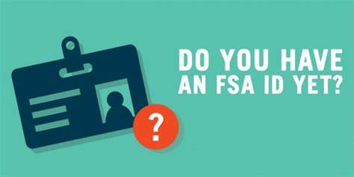
FSA ID Reminders
A user can only have one account associated with his or her Social Security number.
You and your parent BOTH need to set up an FSA ID as soon as possible so you will be ready to sign your FAFSA electronically.
You’ll need your parents’ social security number and your social security number.
An email address and mobile phone number cannot be used with more than one FSA ID.
If you share an email address with someone else, then only one of you will be able to use that email address to create an FSA ID. This applies to your mobile phone number too.

Slide 8

ASK BENJI
Questions about FAFSA?
ASK BENJI has the answers about FAFSA?
Free 24/7 FAFSA support to help Arizona families fill out the FAFSA and access thousands of dollars of grants, loans, and scholarships to help pay for college after high school.
Text “Hi Benji” to 602-786-8171

Slide 9

Basha FAFSA Night Open Lab night 12/3 5-7pm Basha Library
Save the date for the in-person FAFSA lab night at Basha Library on
  12-3 from 5-7p.m.
FAFSA experts will be there to help you and your family complete the FAFSA.
Sign-ups will come out in November. Look on your google classroom for FAFSA announcements and sign-ups.

